Slide 1

Movies from Streaming Platforms
Kappa Team

Slide 2




BOOTCAMP
Meet Our Kappa Team
Edgar Alejo
José Luis Duarte
Joaquin Osio
Pedro Terrazas

Slide 3


KAPPA TEAM
About Our Project
Background
The global video streaming market size was estimated at USD 42.6 billion in 2019 and is expected to reach USD 50.1 billion in 2020 and is expected to grow at a compound annual growth rate of 20.4% from 2020 to 2027 to reach USD 184.2 billion by 2027.
The video streaming services have experienced a rise of around 30% in viewership during the lockdown.
Our project consists of Analyzing the Movie Database of 4 major platforms, including Netflix, Prime Video, Disney+ and Hulu obtained from site Kaggle.
DATA SOURCE: https://www.kaggle.com/ruchi798/movies-on-netflix-prime-video-hulu-and-disney
Source: https://www.grandviewresearch.com/industry-analysis/video-streaming-market

Slide 4




STAGES
Project Process
Explain
Explain what happens in this industry and why, by answering a series of questions that we previously elaborated for this Database
Analyze
Discover and Identify relations, behavior, comparisons and tendencies among the data.
Clean
Determine the quality of the data, as well as the number of nulls values regarding the relevance for the entire database.
Describe
Know the structure, shape and conditions about our Database, identify each columns, data type and general information.
Notes:
The stages of the Project are, Describe the database, Clean our dataset of Nulls, or weird characters, Analyze the data and its relations generating some conclusions about the streaming market

Slide 5
PROJECT 1
Questions
Which platform has the most extensive movie catalog?
Which streaming platform has the most exclusive movies?
Are there any tendencies within the platform age ratings?
Do they care about movie IMDb rating?
Besides English, which languages are the most popular?

Slide 6
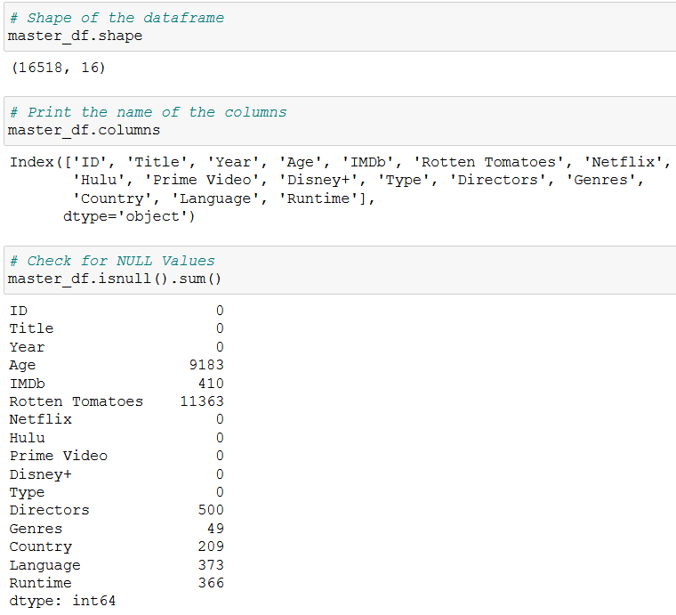
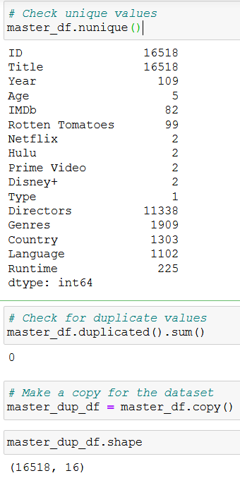
PROJECT 1
Describe
Notes:
We have 16 columns one to them was useful (Type column)
Almost 16.5 k records no duplicated

Slide 7
PROJECT 1
Clean
16.5K
15.8K
300
339
Original Records
Records without Language, Country & Directors
Records that were replaced with “No Director”
Final Database
In order to get our final Database:
300 records were eliminated with null values.
Almost 300 NULL records were filled
31 special characters were replaced in some columns
Notes:
We eliminated 300 record where 3 importants columns had NULLs such as Duration, Country and Language
Replaced almost 300 NULL records with “No Director” string
Replaced 31 special characters into Director & Title columns

Slide 8
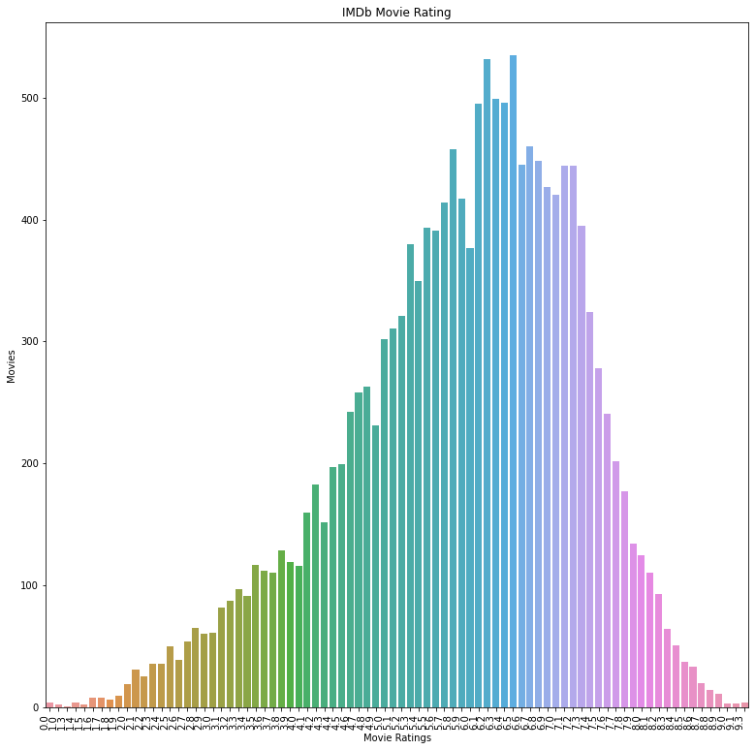




PROJECT 1
IMDb Movie Ratings
Data Cleansing
For this segment, only movies with IMDb ratings where used as valid data.
Movies
15,543 total movies between 4 different streaming platforms
Avg. Movie Rating
The IMDb average movie rating between all 4 platforms is of 5.9/10 with more than 500 movies in this grade.
Best movies
5 movies with a 9.3/10 grade
83% of top movies – Prime Video
17% of top movies – Netflix

Slide 9
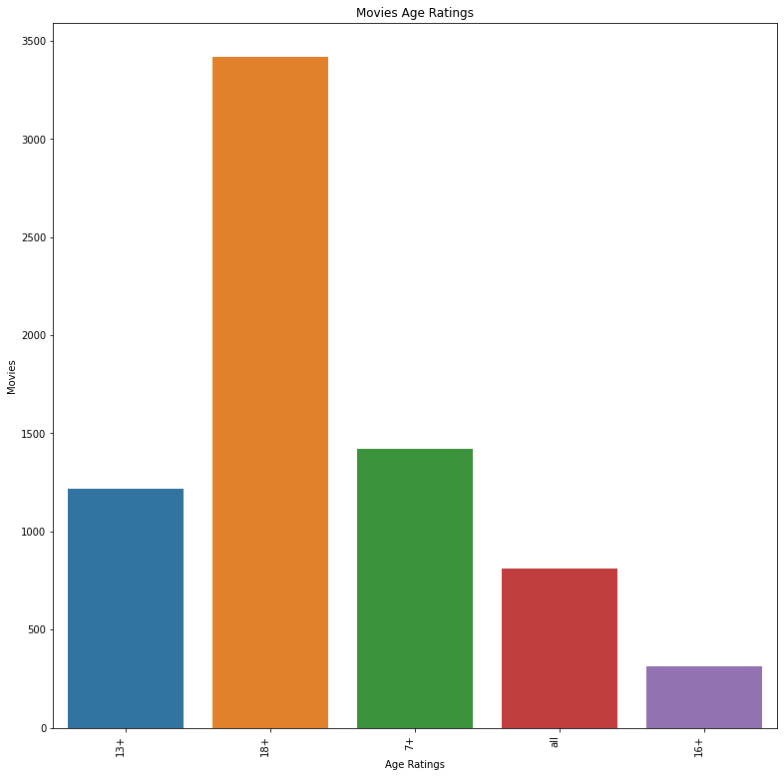




PROJECT 1
Age Rating by Platform
Data cleansing – Movies age Rate
7,567 total movies between 4 different streaming platforms
18+
All
18+
18+
13+
7+
13+
7+

Slide 10
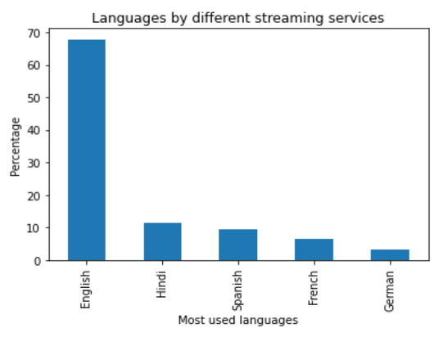
PROJECT 1
Movie Languages
Languages
With 68% English is the main used language in the movie database, which is expected as the USA is the most important country in Production credentials.
Hindi and Spanish are second and third, respectively, with nearly 10%.

Slide 11
PROJECT 1
Movie Languages by Platform
Main Languages – Excluding English
Platform Structure
Once we exclude English in the analysis, French and Spanish appear as the main languages in three of the four platforms.
However, there is some specialization among platforms when we consider the top 5 languages.
1:French
1:French
1:Hindi
1:French
2:Spanish
5: Japanese
2:Spanish
5: Italian
2:Spanish
5: German
2:Spanish
5: Italian

Slide 12
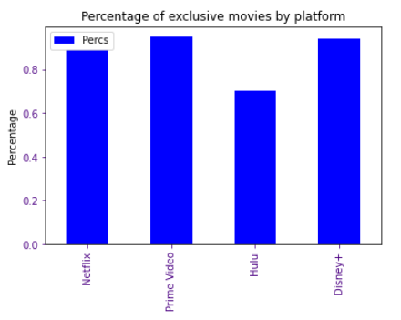
PROJECT 1
Exclusive Movies by Platform
Data cleansing – Exclusive by platform
15237 total movies between 4 different streaming platforms 96%
70%
94%
89%
95%
616
519
2898
11204

Slide 13
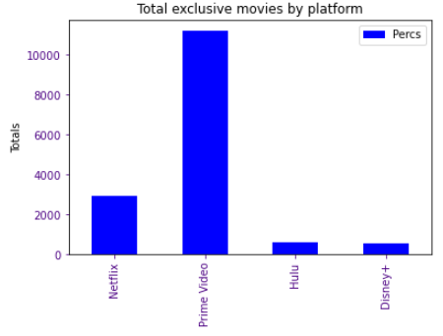
PROJECT 1
Exclusive Movies by Platform
Data cleansing – Exclusive by platform
15237 total movies between 4 different streaming platforms 96%
70%
94%
18+
18+
616
519
2,898
11,204

Slide 14
PROJECT 1
Conclusions and Findings
Prime Video is the platform that has the biggest movie catalog.
All platforms business models are movie exclusivity based.
The IMDb rating has a Normal Distribution across all platforms.
Hindi and Spanish are the two most important non-English languages.
For future research we propose:
Exploring the Customer Demand vs our findings.
Exploring the Series database vs Movies database to see if there are any trends.

